Slide 1
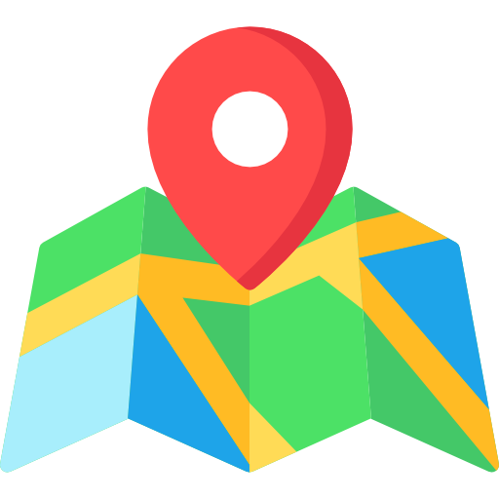
City Guide
Find nearby places

Slide 2
Contents
Purpose
Tech Stack
End Users
Future Enhancements
What We Learnt
Reference

Slide 3
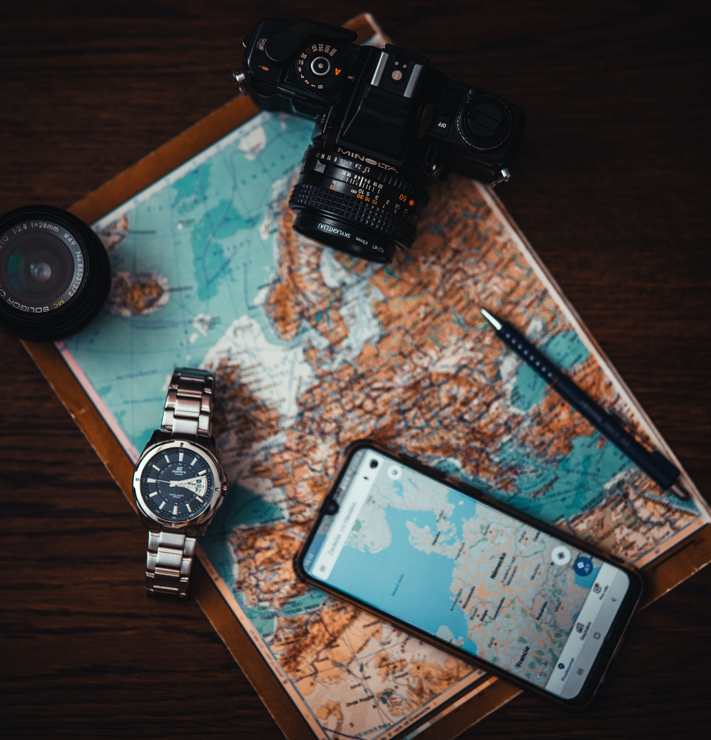
Purpose
Want to try out a new hangout place?
Short on cash and don’t know nearby atm.
Or just want to find out a park nearby for an evening walk.
The City Guide will help the users by fetching a nearby places list from the google places API.

Slide 4















Tech Stack
Android
Java
XML
Places API
JSON
Android Studio IDE
Java for backend logic
For designing user interface
For fetching list of nearby places
Used for communication with API

Slide 5

End Users
Travelers
Local people’s
Wondering where to get the best fast food
Wants to explore the most happening things to do in city
For the people who want to save time
Who Wants to discover new places

Slide 6

Future Enhancements
Local Community
In-app rating
Search feature
Will develop the functionality where users can also participate
Users will be able to post and interact with each other
Users can rate any place within the app
Will be able to write feedback & suggestions
Search feature for finding exactly what you’re looking for

Slide 7
What we learnt
JSON for communicating with the server.
Handling the network calls
Using Google Maps in android.

Slide 8
Reference
Google Places API
Android Developers Guide

Slide 9
Thank you
Project by -
Poras Shrivas
Aadarsh Gupta
Vikas Kushwaha
Gudlak Maurya

